Slide 1
Operating Cost Context
A recently installed chair lift has increased operating costs by $1.54M
Should BMR find ways to reduce operating costs while trying to keep as much support for ticket prices as possible?
Should BMR double down and invest even more in the business by adding new facilities and features to the resort?

Slide 2
Ticket Price Context
BMR has also historically charged a premium above the average price in its market segment and would like a more data driven business strategy to examine ticket prices in relation to competitors
Is there further room to raise ticket prices in order to offset the investments in new facilities?
Is BMR providing the right value in support of its current ticket price?

Slide 3
Recommendation and Key findings
BMR’s facilities adult weekend ticket price should be set at $96. This is up from the current $81 and also has a healthy MAE of $10. Also can charge a premium for weekend prices.
With the right investments in certain facilities and features of ski resorts, it is also possible to further increase revenue and possibly profits.
Closing down certain runs is also a possible cost cutting measure that BMR can implement.

Slide 4
Metrics that Affect Ticket Price
Large Affect
Little to No Affect
Fast Quads
Total Runs
Snow Making Acres
Vertical Drop
Skiable Terrain Acres
Total Chairs
Quads
Trams
Terrain Parks
Triples
Surface
Doubles
Fast Sixes
Longest Run

Slide 5
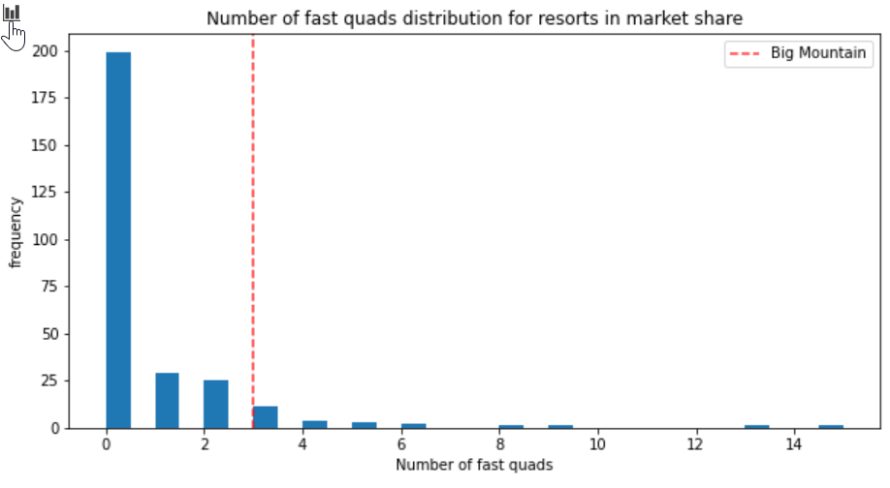
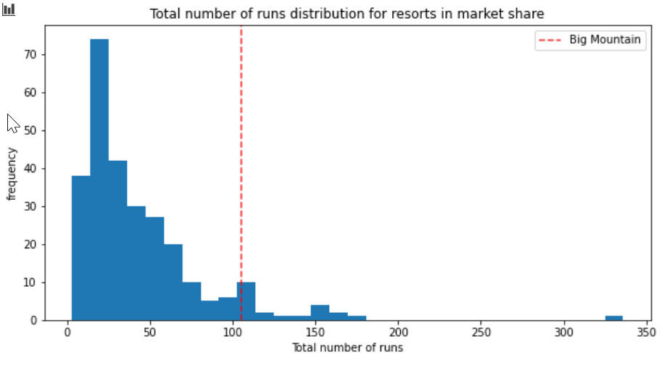
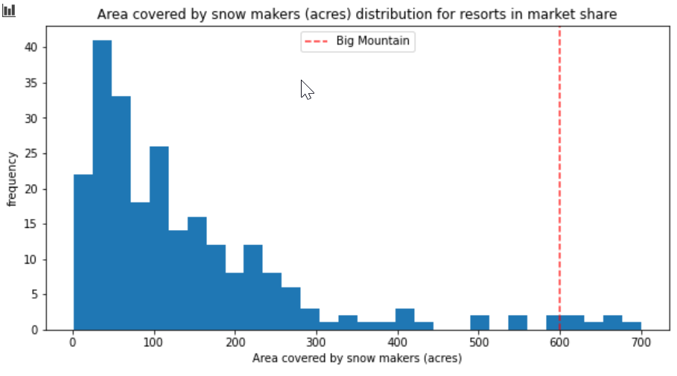
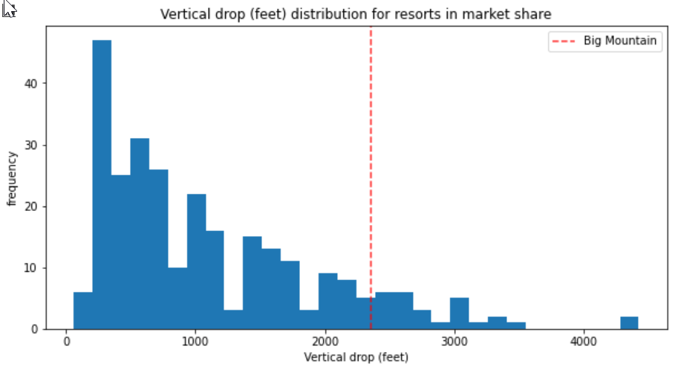
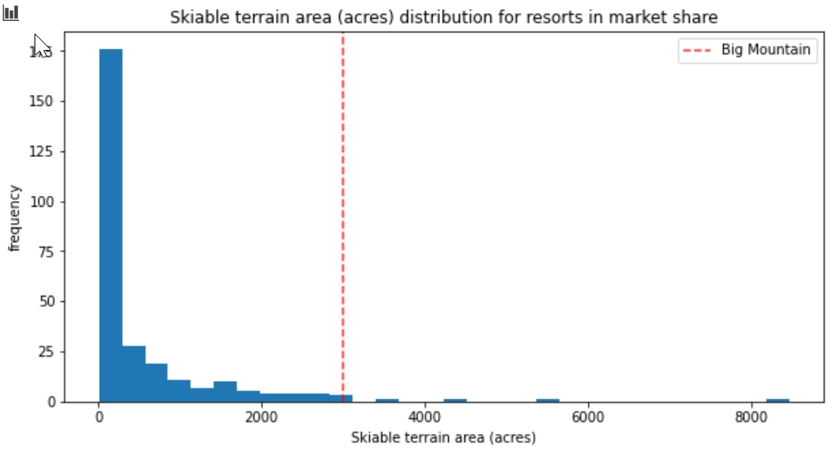
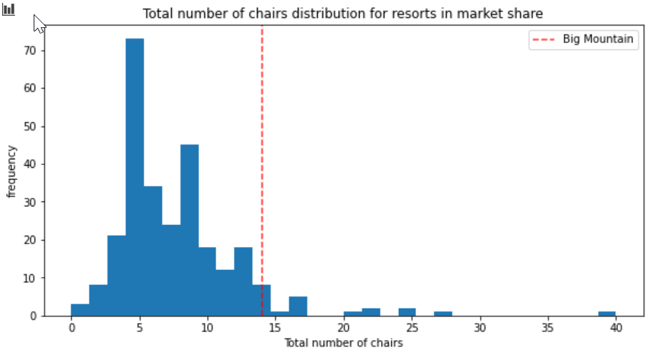
How does BMR ski features compare across the US?

Slide 6
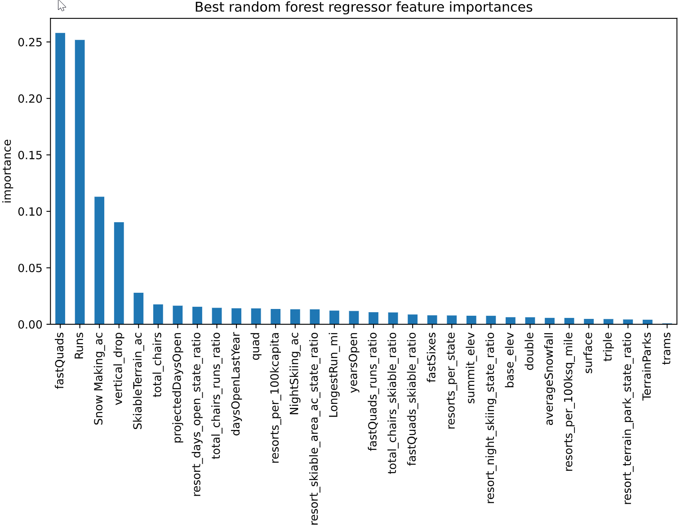
Factors and Weight Affecting Ticket Prices

Slide 7
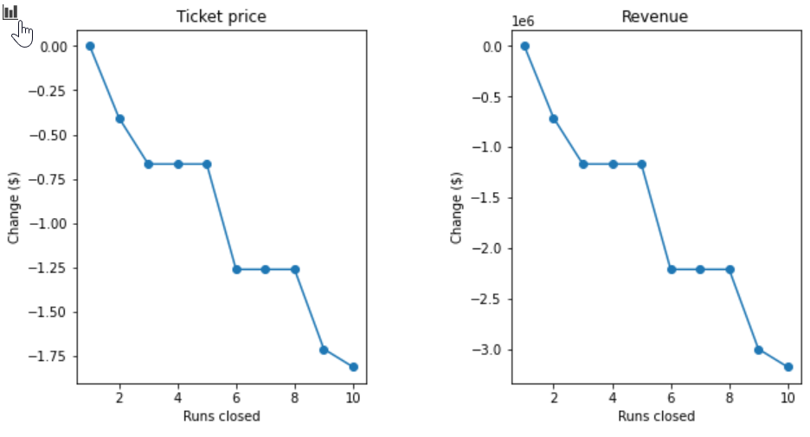
Scenario 1: Runs Closed vs Ticket Prices
Example scenario of how decreasing the number of runs might affect ticket price and resulting revenue.

Slide 8
Other requested Scenario Summaries
Scenario 2:
Add a run, increase vertical drop by 150 ft, and install additional chair lift
RESULT: Supports increase of ticket price by almost $2, and revenue increase of $3.47M
Scenario 3:
Scenario 2 + 2 additional acres of snow Making
RESULT: The small % increase of snow making area has no impact
Scenario 4:
Add 0.2mi to longest run and add 4 acres of snow making
RESULT: The small % increase to both metrics has no impact

Slide 9
Summary and Conclusion
BMR has further room to increase ticket prices based upon comparisons with other ski resorts across the nation. BMR does charge a premium in Montana, but this works because BMR dominates the local Montana market.
Cost cutting measures can also be implemented without a large hit to revenue. i.e. terrain parks, triples, doubles, fast Sixes, night skiing acres
Investments in fast quads, runs, snow making acres, vertical drop, and skiable terrain would support increases in ticket prices.
Conclusion:
BMR should first experiment with raising ticket prices since this is likely the easiest to implement. BMR can also implement cost reductions to operating expenses or invest in certain features that affect ticket prices more.

